Slide 1
De-noising of Speech Signal Using Digital Filters
Mohammad Navid Nayyem (ID – 172014003)
Sabiha Sumaiya (ID – 172014007)
Md. Asraf Ali (ID – 172014008)
Abdulla Al Numan (ID – 172014013)

Slide 2
Outlines
Play the audio and show the magnitude plot of audio signal
Find out the periodicity of the audio signal
Process of Filter Designing and Plotting Magnitude Response, Phase and the pole-zero Diagram
Filter noisy signal using your de-noising filter

Slide 3
Play the Audio File
AudioRead (filename,audio data,fs)
audioPlayer (function)
Player(variable)
fft(converts original domain)
Nfft-Length of the Fourier series
Plot-create frequency and plot magnitude as a frequency HZ.

Slide 4
Find out the Periodicity
audioread function
periodogram(x, window, f, fs) function
Peaks of signal using findpeaks(X, f) function
Time period using max(diff(locs))

Slide 5
Process of Filter Designing
graphical user interface
analyzing filters, such as magnitude and phase response plots and pole-zero plots.
export the filter as an object
call the filter as an object
workspace extension is → .mat
filter design extension is →.fda

Slide 6
Best Four Filters
Types of Filter Design Method Types of Window Beta Value Fs Fc
Lowpass FIR - Window Hamming 42000 4000
Lowpass FIR - Window Kaiser 3.5 100 1
Lowpass FIR - Window Kaiser 2.5 22000 0.2
Lowpass FIR - Window Triangle 44100 5000

Slide 7
Filtering Process
audioread(audio_data)
fft(audio_data,Nfft)
filter(designed_filter, audio_data)
play(filtered_signal)
plot(filtered_signal) and (ft_signal)

Slide 8
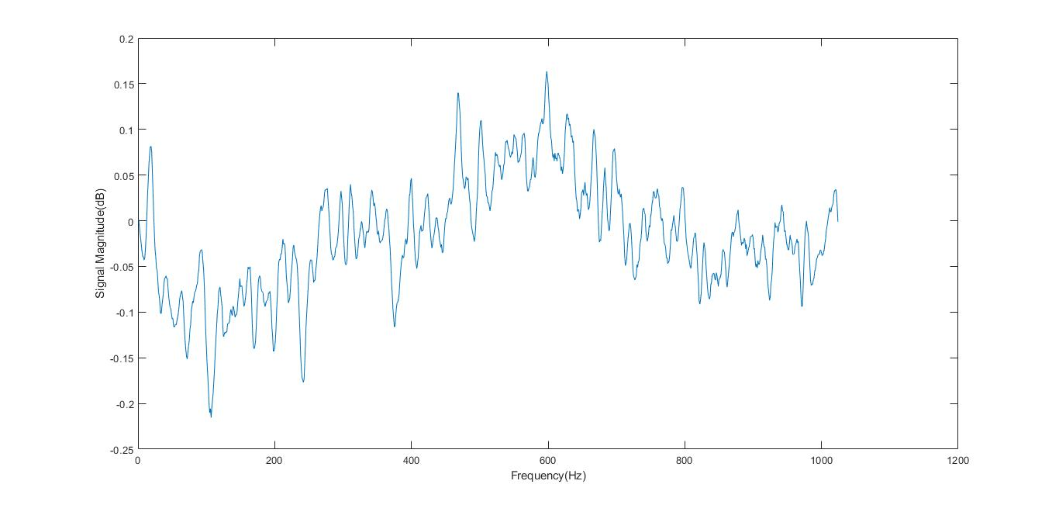
Plotted Filtered Signal

Slide 9
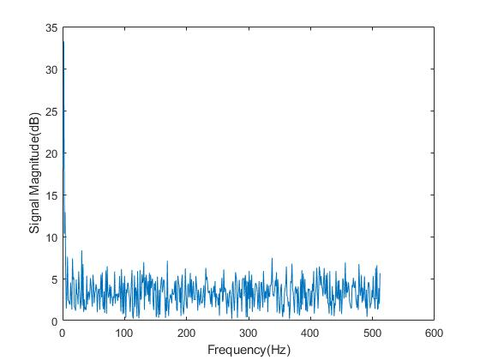
Original Signal

Slide 10
THANKS FOR WATCHING

